Slide 1

Predictive Analysis of Fixed Term Deposit Subscriptions
Analytics Project
Michèle Fille, Rahel Häusler & Jervin Ureath
Notes:
As in the previous meetings discussed, tasked to do
Here to present the findings

Slide 2
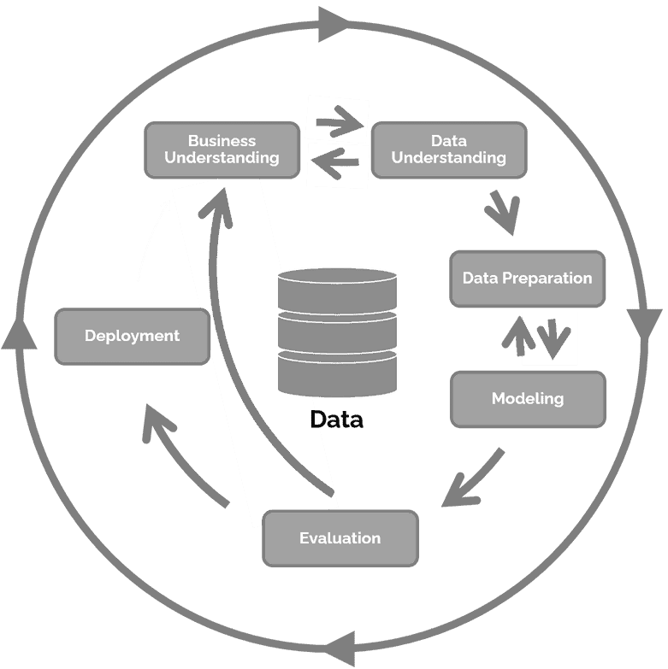
Agenda
Understand project objectives and business context to direct efforts towards achieving project goals
Use R, R Studio, and Orange to analyze the dataset, gaining insights into data quality and relevance
Prepare a clean, structured dataset for modeling
Develop and refine predictive models using Orange, focusing on classification accuracy and ROC evaluation.
Evaluate model effectiveness in meeting project objectives
Notes:
Approached the project with the CRISP-DM
Phases are iterative

Slide 3






Business Understanding
Data Collection
Impact
Bank’s response
Objectives
Risks
Benefits
Notes:
May 2008 – Nov 2010
Financial / Euro Crisis
Credit-worthiness decreased
Rising financing costs for lending money
Seek alternative financing → Fixed term deposits good solution
Stability and efficiently manage liquidity
Optimize resource allocation and success of marketing efforts
Data privacy and protection → Bad reputation
Also if the empl. Only relies on the model and no own thoughts
Securing funds
Higher conversion rate

Slide 4
Business Understanding
Success Criteria:
Key Performance Metric → Classification Accuracy
Target: 0.80
Examination of the ROC curve
Scalability, efficiency and processing large size of data
Notes:
High level of accuracy
Effectively use resource and no bad reputation

Slide 5
Data Understanding
16 Variables &
1 Target Variable
age
7 Numerical
previous
41,188 Records
campain
employment variation rate
consumer price index
consumer confidence index
euribor 3 months
10 Categorical
10,700 Records with NA
(26%)
job
marital
education
1,980 duplicated Records
default
1 Target Variable
housing
loan
month
day of week
y (subscription)
poutcome
Notes:
Numerical
age
previous → Number of contacts performed before this campaign
campain → Number of contacts performed during this campaign
employment variation rate
consumer price index
consumer confidence index
euribor 3 months
Categorical
job
marital
education
default
housing → housing loan
loan
day of week
month
poutcome → Outcome of the previous marketing campaign
y → target variable: subscription to a fixed term deposit

Slide 6
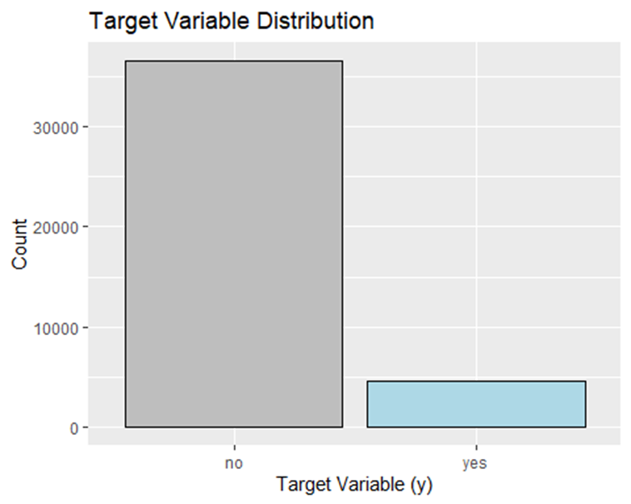
Data Understanding
Data imbalance on `y`
Missing variable `year`
Dirty data
36,548 Records
88.73%
4,640 Records
11.27%

Slide 7
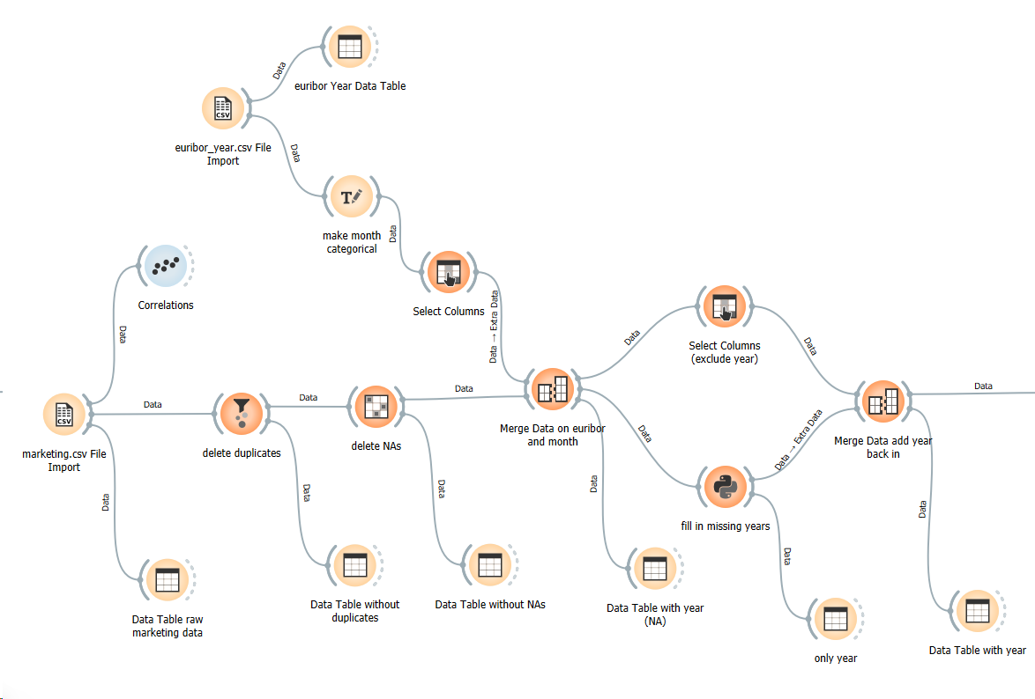
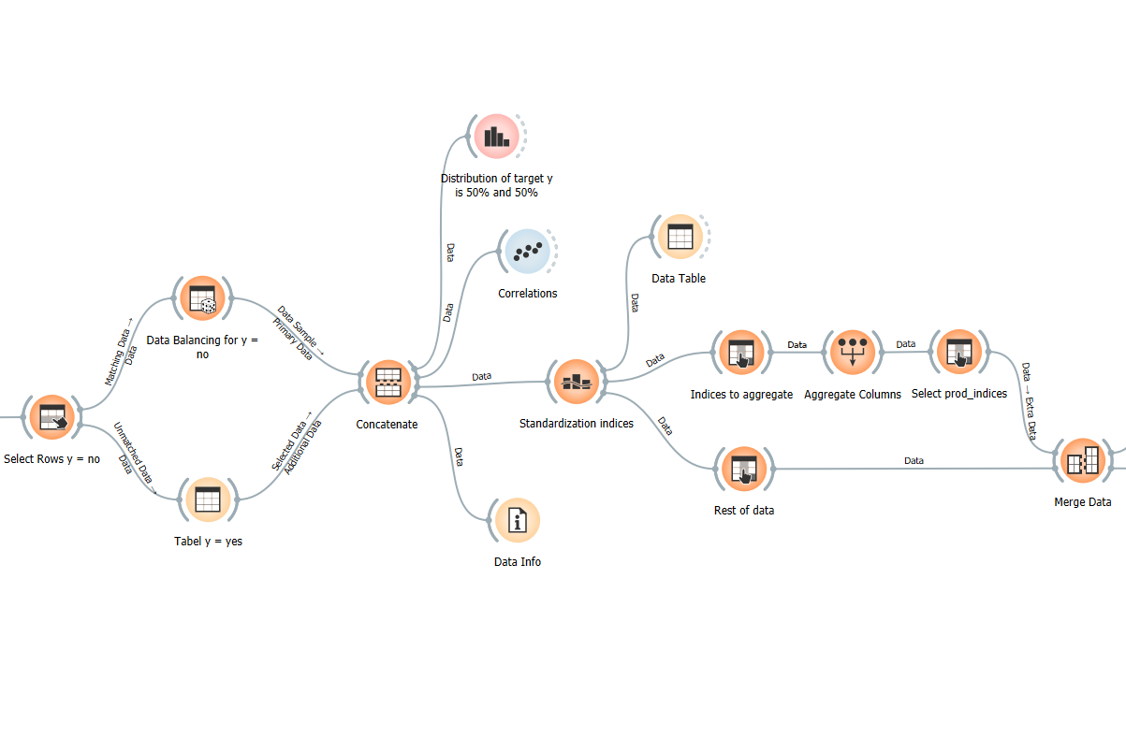
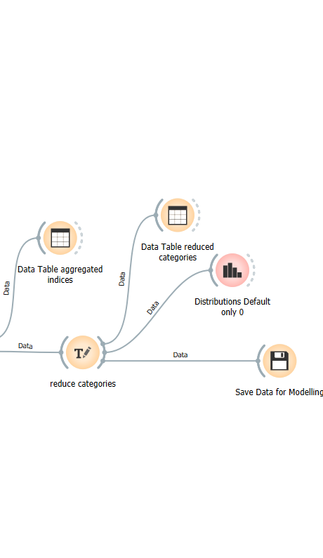
Data Preparation

Slide 8
Notes:
Standardize respectively normalize economic indices and rates.
The mean was subtracted from each value and the result then gets divided by the standard deviation of the variable.
Data standardization ensures consistency and compatibility across datasets, facilitating efficient processing and analysis. By transforming data into a standard format, it becomes easier to compare and interpret, benefiting both humans and machines.

Slide 9
Notes:
Example: Categories of variable education were grouped and added into three new categories: basic, itermediate, high.

Slide 10
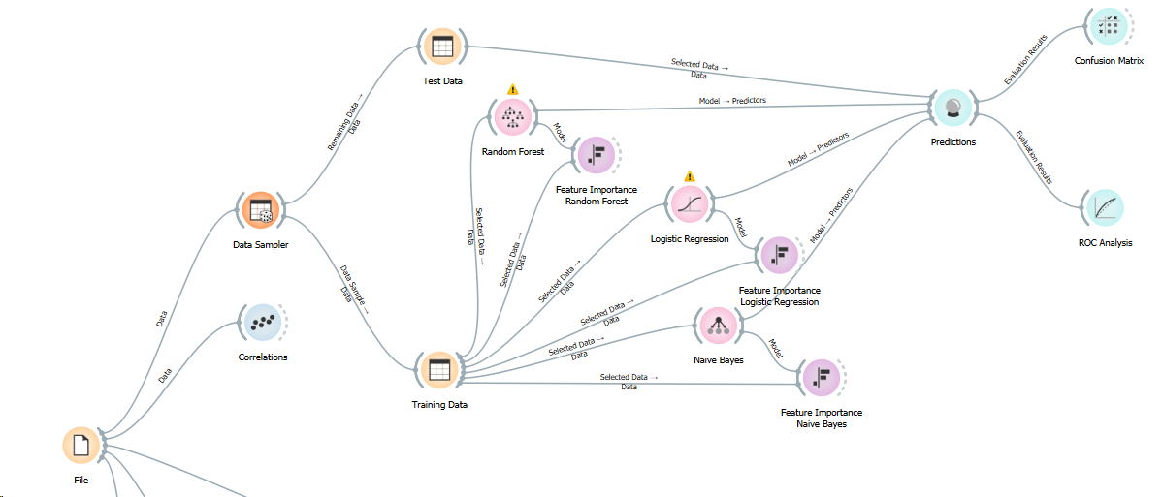
Feature Selection
Notes:
Michèle

Slide 11
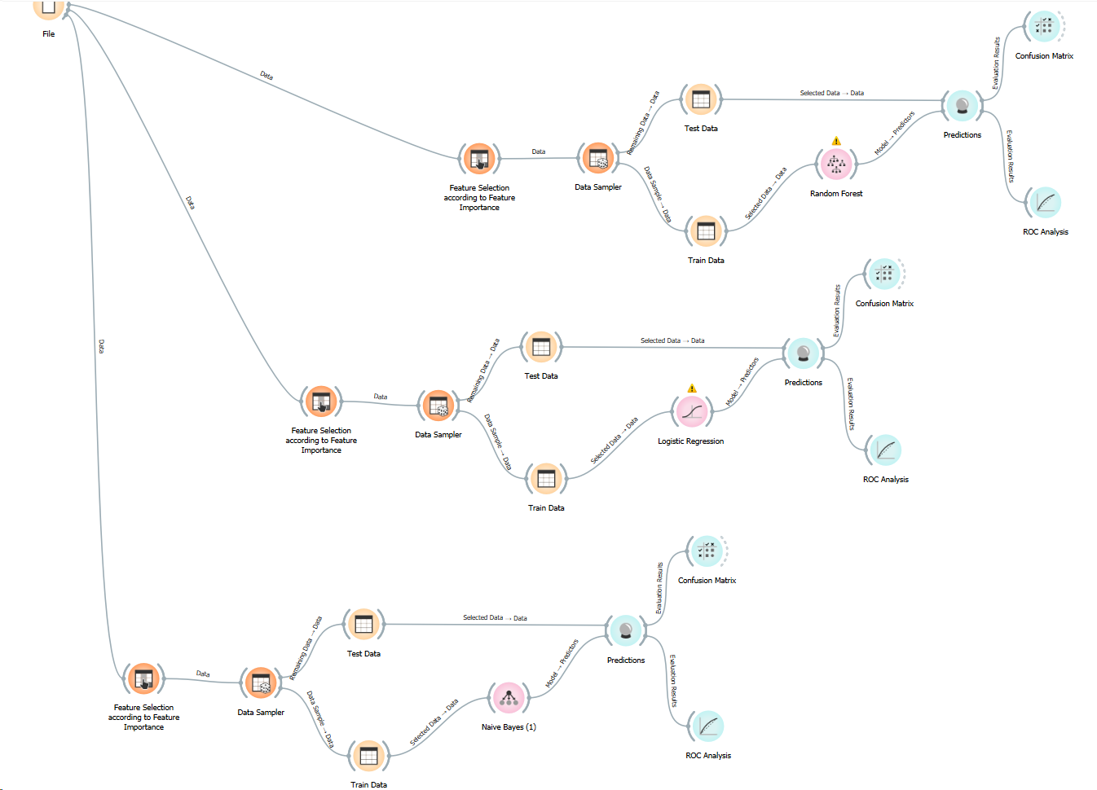
Modelling
Notes:
Feature Selection – Data Sampling (80% Training, 20 Test),
First Selection of Model: considered 6, went with the 3 best
Models have automatic data preparation steps (binarization, binning), individual fine-tuning according to improve performance metrics

Slide 12
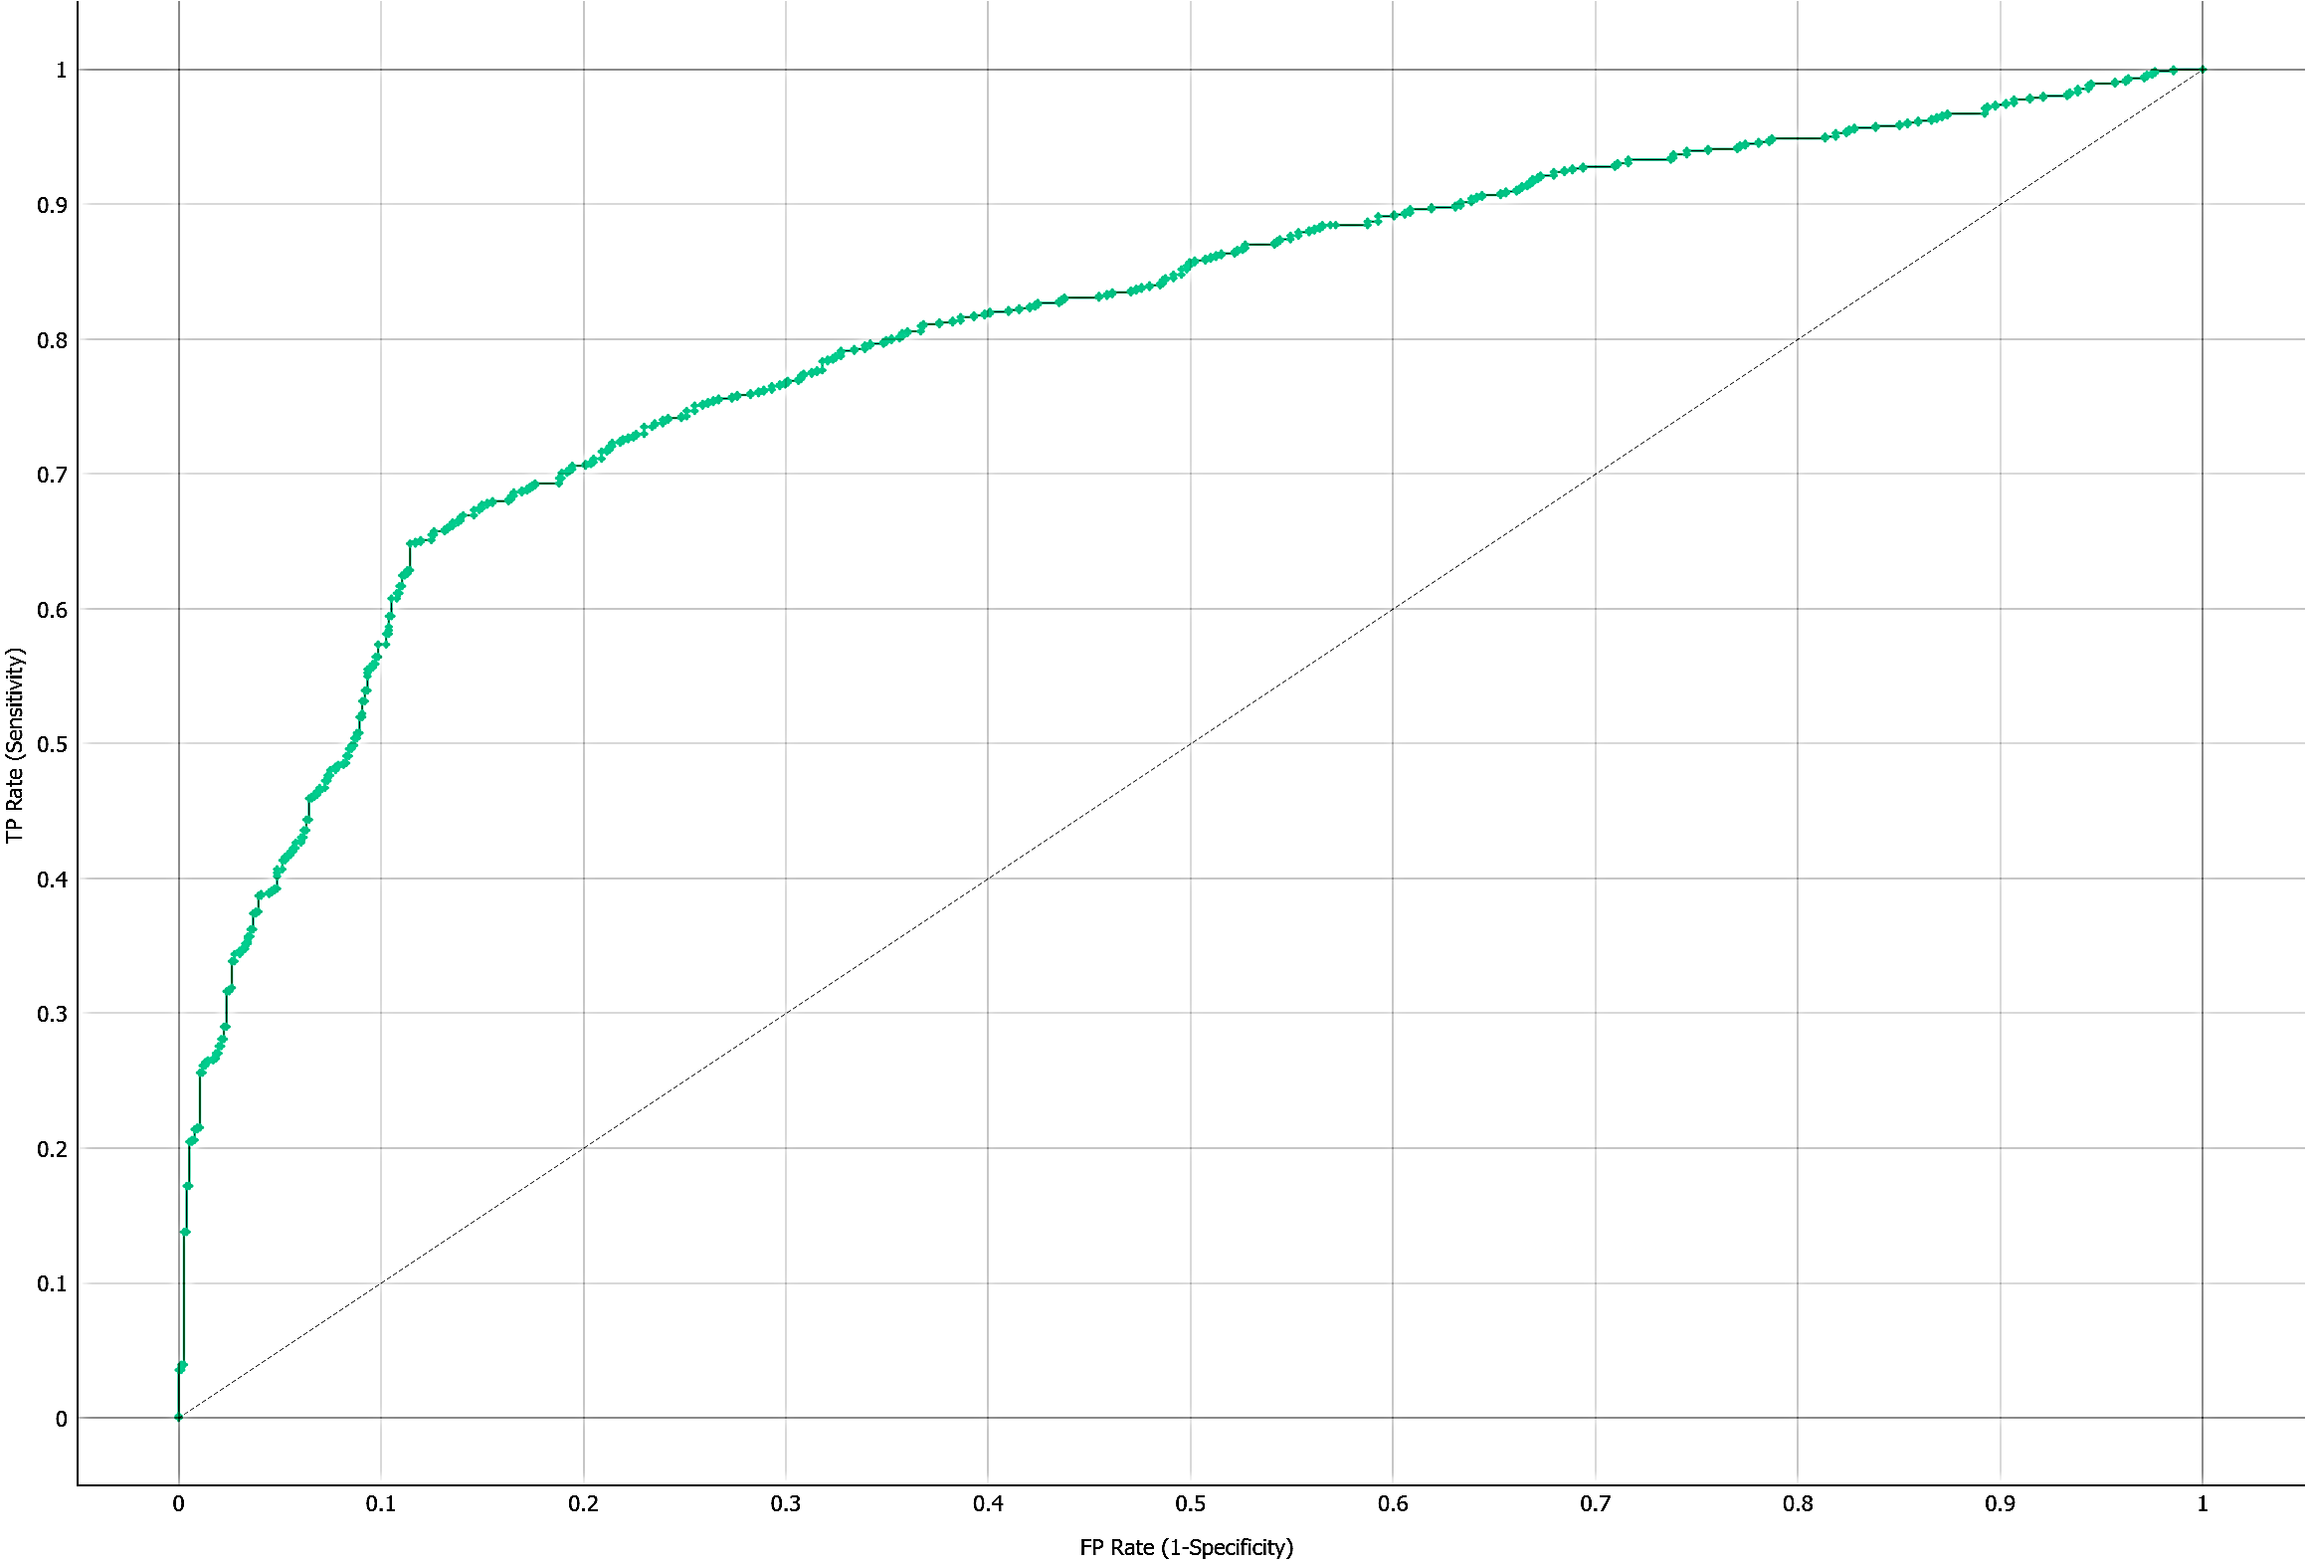
Assessment
Performance Scores Random Forest
ROC Curve
AUC | CA | F1 | Precision | Recall | MCC
0.810 | 0.762 | 0.761 | 0.770 | 0.762 | 0.532
 | Predicted
Actual |  | 0 | 1 | ∑
 | 0 | 643 (84.5%) | 118 (15.5%) | 761
 | 1 | 244 (32.0%) | 518 (68.0%) | 762
 | ∑ | 887 | 636 | 1,523
Notes:
Classification Accuracy, Goal: 80%, best model 76%
Roc Curve step rise in the beginning is good

Slide 13





Evaluation & Findings
Deployment
Data Collection
Successful contacts
Review
Increase of conversion rate
Adjustment
Notes:
Data Collection – Income, Assets with other financial institutes

